Slide 1

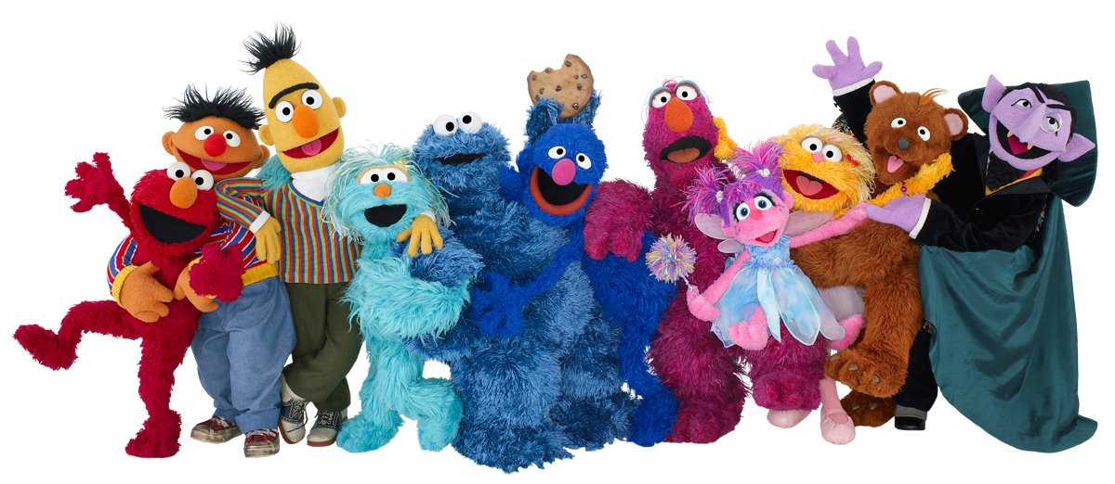
Workshop Can You tell me how to get to Sesame Street? I wanna be a Grails rookie star there!
Fernando Redondo Ramírez
@pronoide_fer

Slide 2
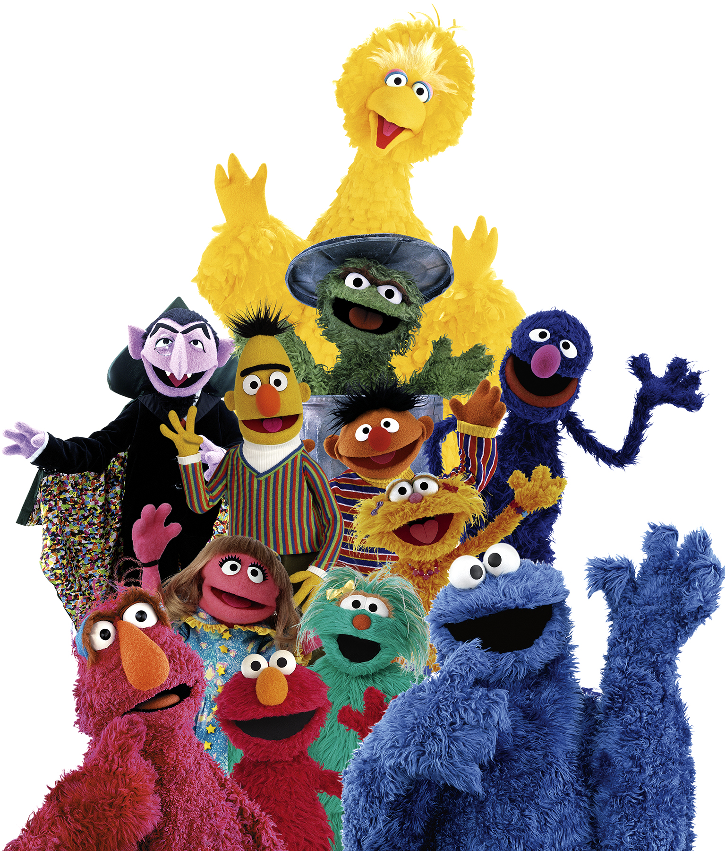
Roadmap
Who am I
Brief introduction…
Hands on!

Slide 3

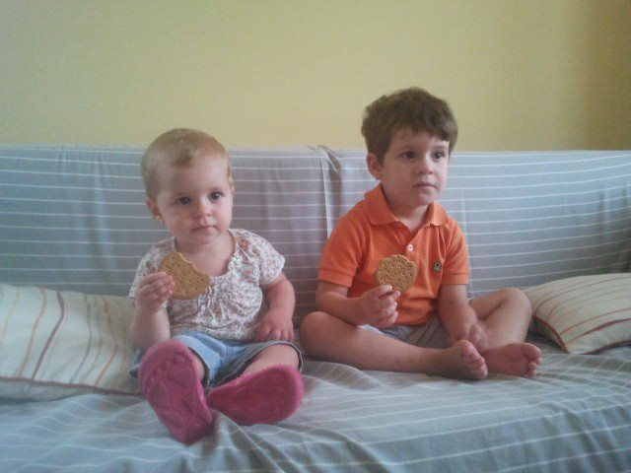
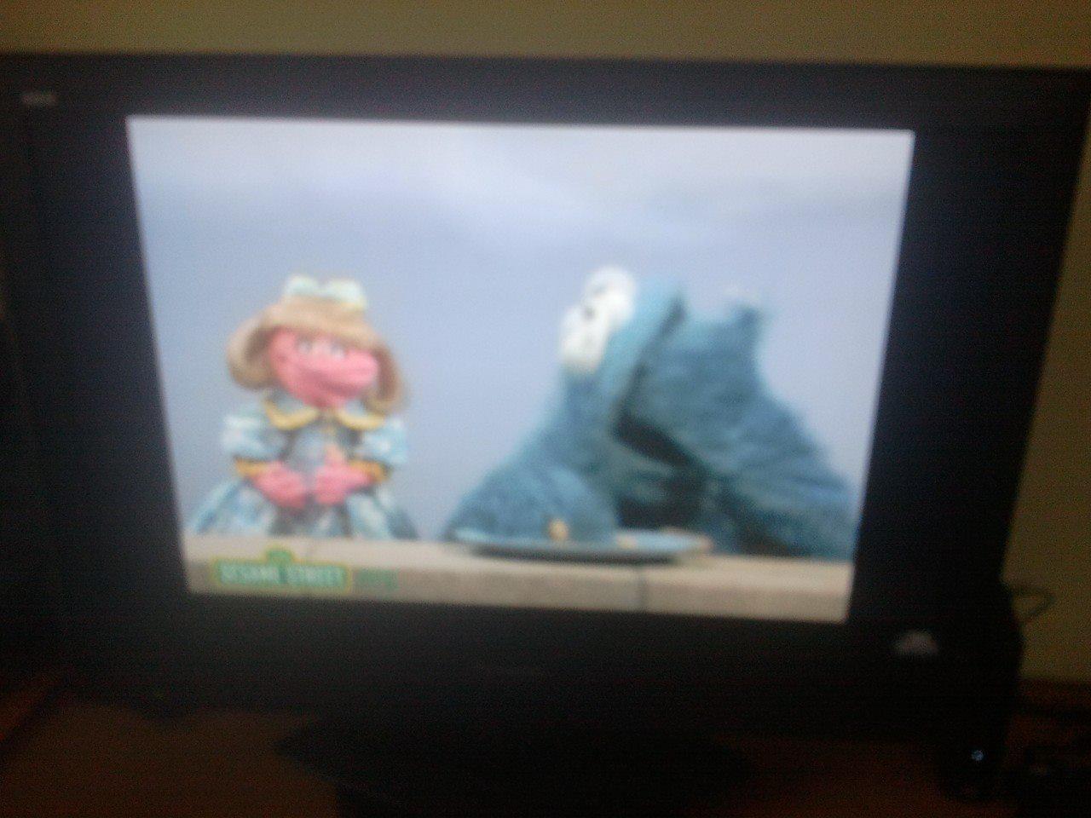
Whoami
Entreprenour and Business Manager at Pronoide since 2003
Java & Friends Trainer
Doing things with Java from 1999 on
Computer Engineer
Happily married and proud father of two children who love all Sesase Street stuff

Slide 4
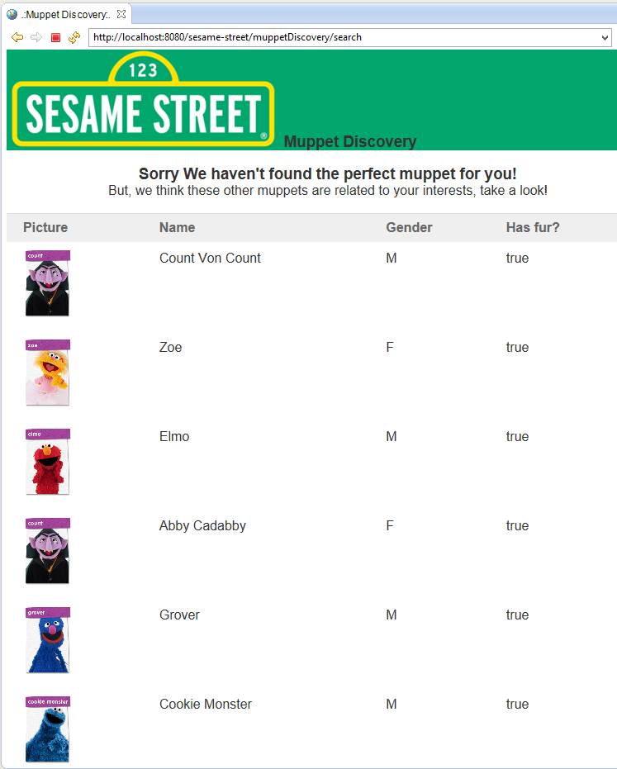
Brief introduction
Just another grails workshop (jagw)?
Yes indeed!, but:
We’ll leverage grails 2
We’ll use TDD and we’re going to do a lot of tests
We’ll deal with the whole app code
We won’t do Scaffolding ;)
No plugins are necessary

Slide 5

Hands on!
Before start, you have to…
Install git in your computer http://git-scm.com/book/en/Getting-Started-Installing-Git
Install jruby or ruby http://jruby.org/getting-started https://www.ruby-lang.org/en/installation/
Install git presenter (gem install git_presenter)
Download Groovy/Grails Tool Suite 3.4 https://spring.io/tools/ggts/all
Start Groovy/Grails Tool Suite 3.4 (GGTS) and choose or create a workspace (remember run it with a JDK)
Download http://pronoide.com/downloads/greach-workshop-2014.zip and unzip it into workspace folder.
Hold on! Please wait me right here…

Slide 6
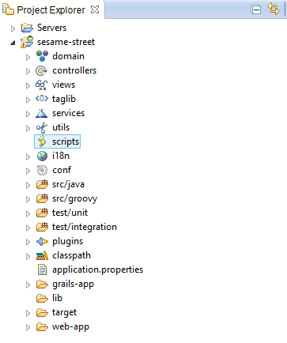
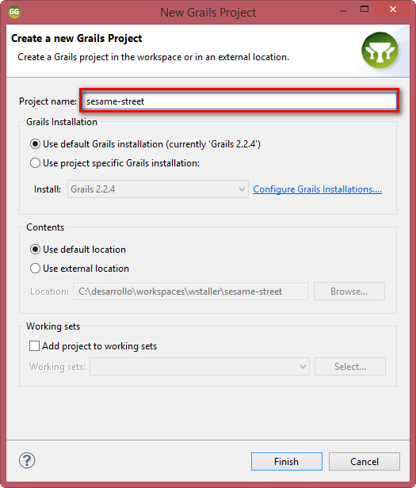
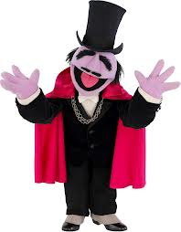
Stage I: Create web application
Create webapp (create-app sesame-street) note: it’s no necessary if you choose the git way

Slide 7
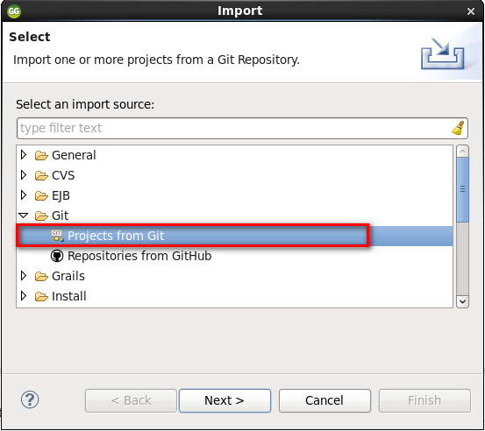
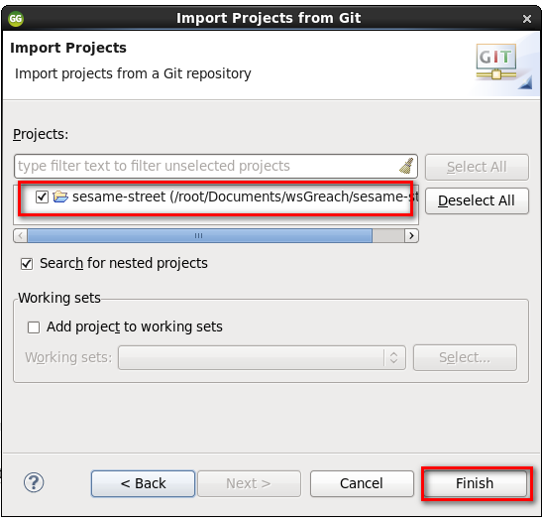
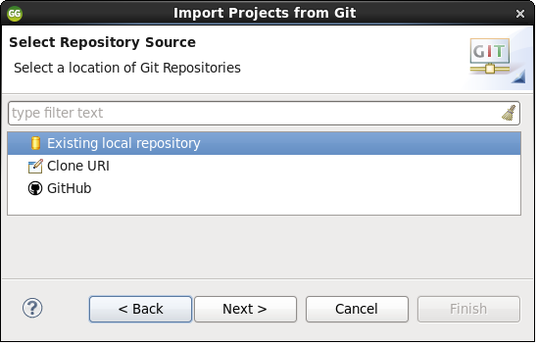

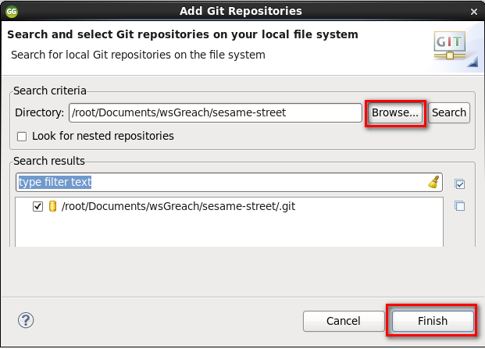
Stage I: Create web application
Import webapp (XXXXXXX) note: it’s compulsory if you choose the git way

Slide 8
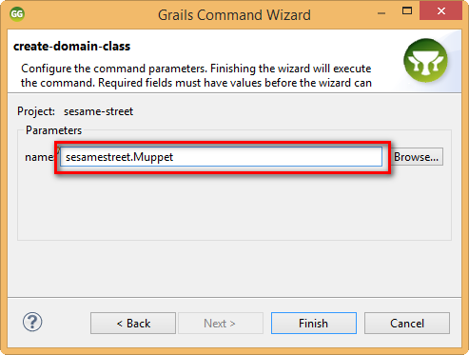
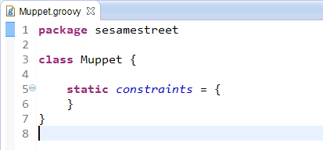

Stage II: Create domain
Create the domain classes (create-domain-class sesamestreet.Muppet)

Slide 9
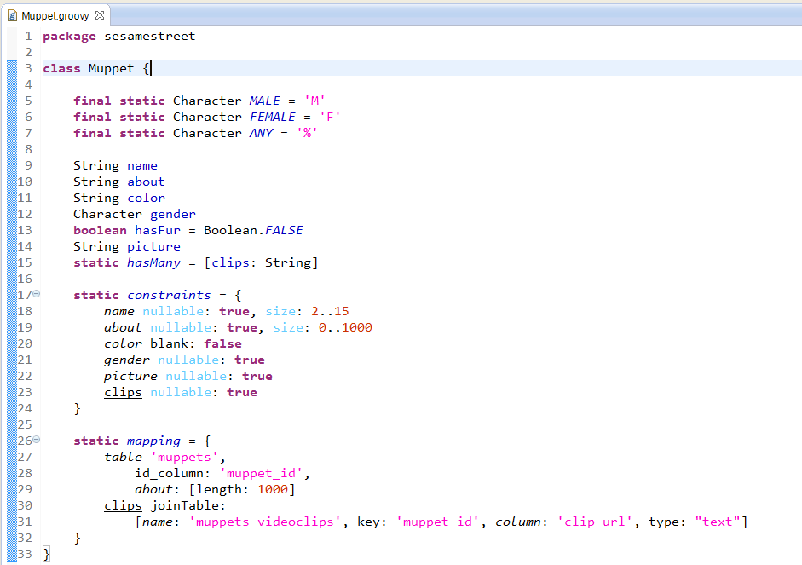

Stage II: Create domain
Define properties, constants, constraints and mappings

Slide 10
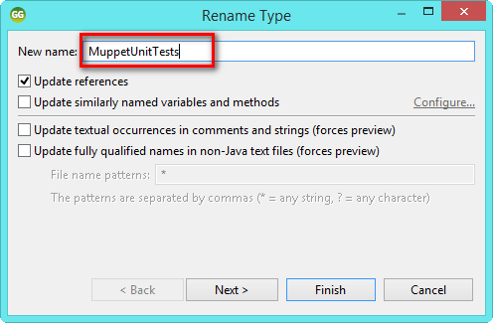
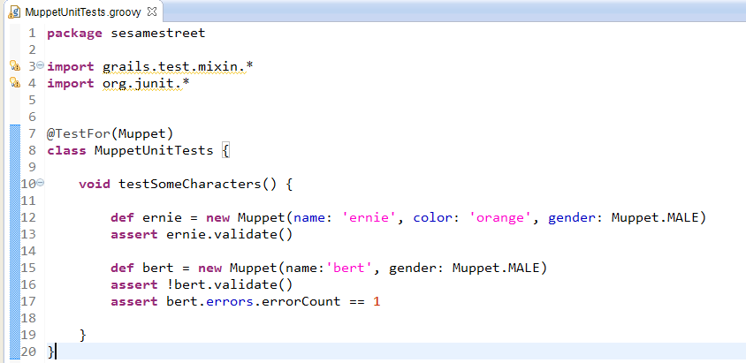

Stage II: Create domain
Let’s refactor and write down a Unit Test

Slide 11

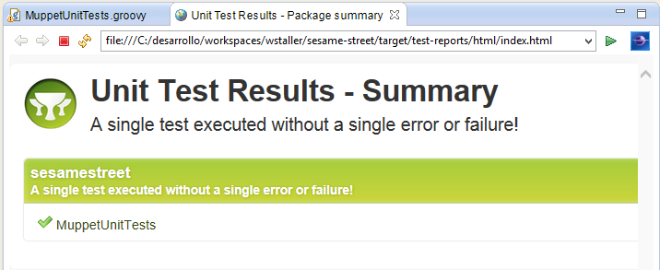
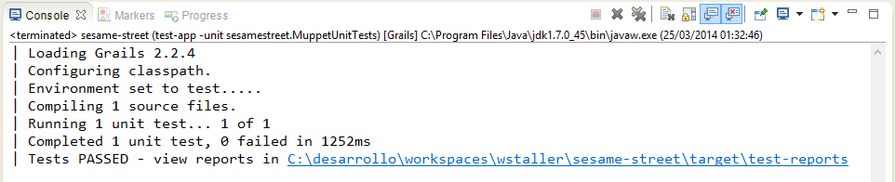
Stage II: Create domain
Run Unit tests (test-app)

Slide 12
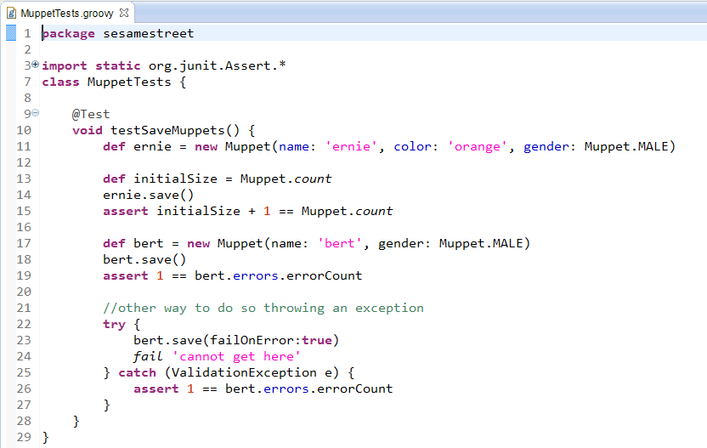


Stage II: Create domain
Write an integration test (create-integration-test ) and run it (test-app integration:)

Slide 13

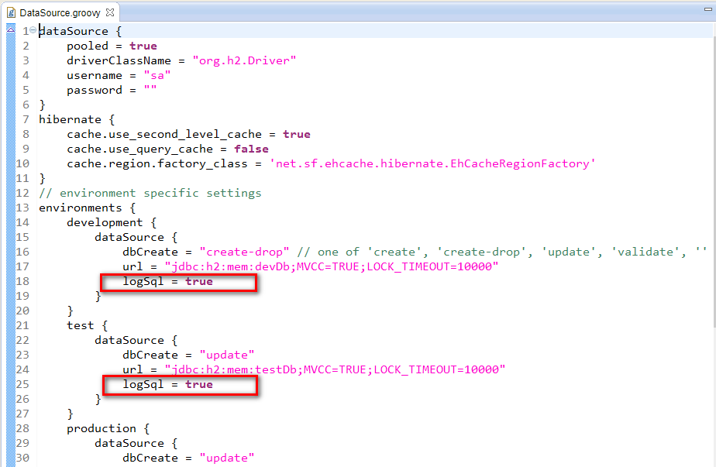
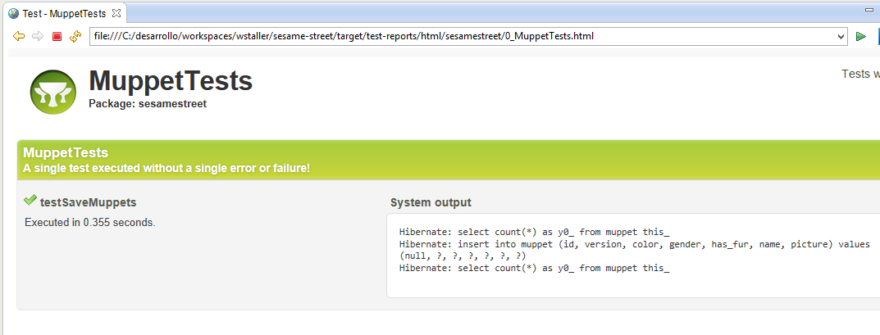
Stage II: Create domain
Let’s change database config and run again (test-app integration:)

Slide 14
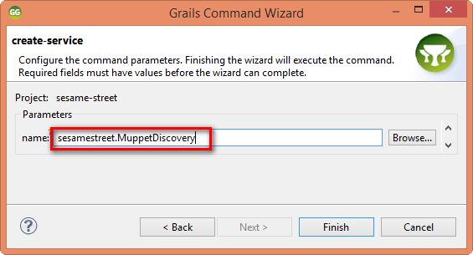
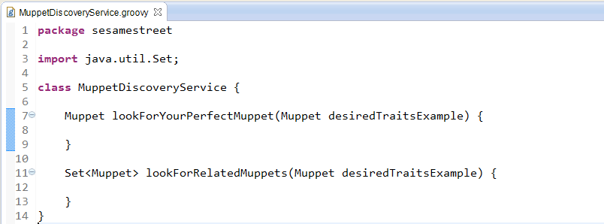

Stage III: Create business layer
We have to create the service skeleton (create-service sesamestret.MuppetDiscovery)

Slide 15
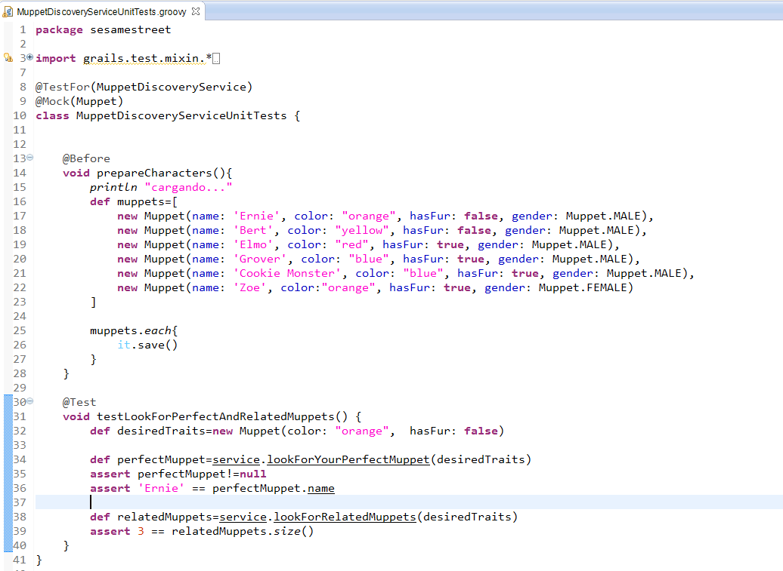
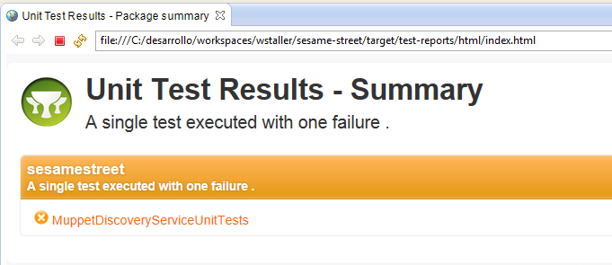

Stage III: Create business layer
Let’s write the unit test first and run it (test-app -unit sesamestreet.MuppetDiscoveryServiceUnitTests)

Slide 16

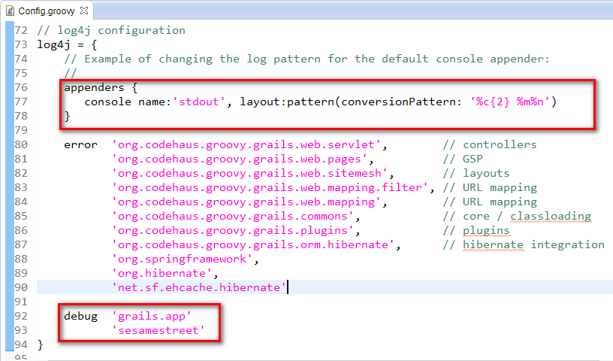
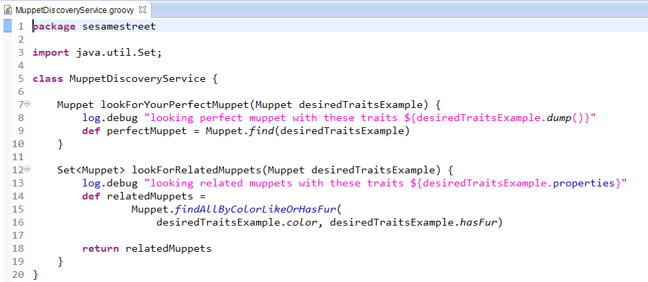
Stage III: Create business layer
Implement this service and its logging

Slide 17
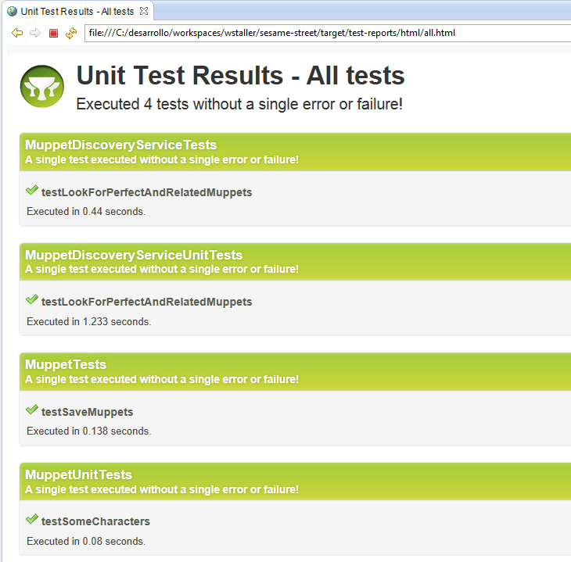
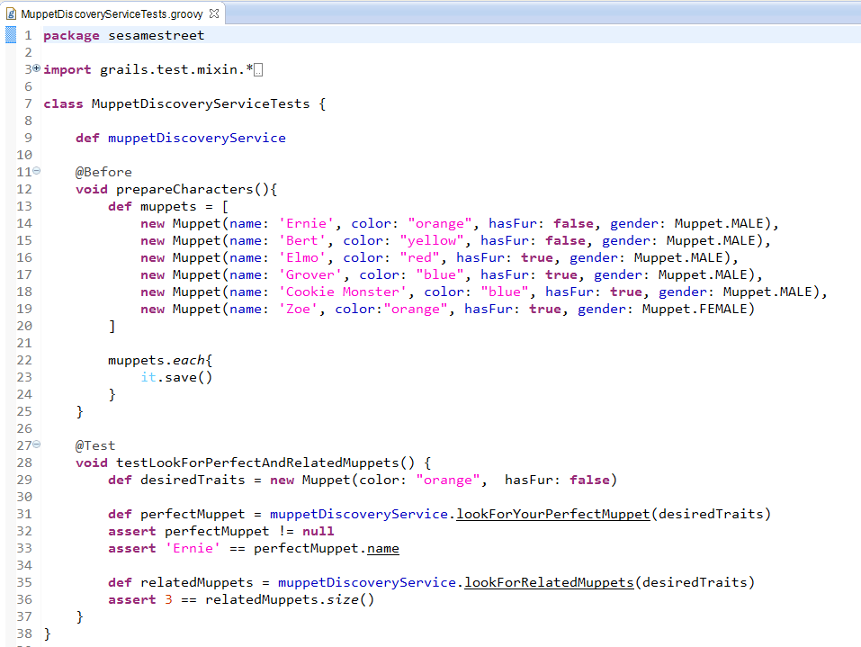

Stage III: Create business layer
create an integration test and run all tests (test-app)

Slide 18
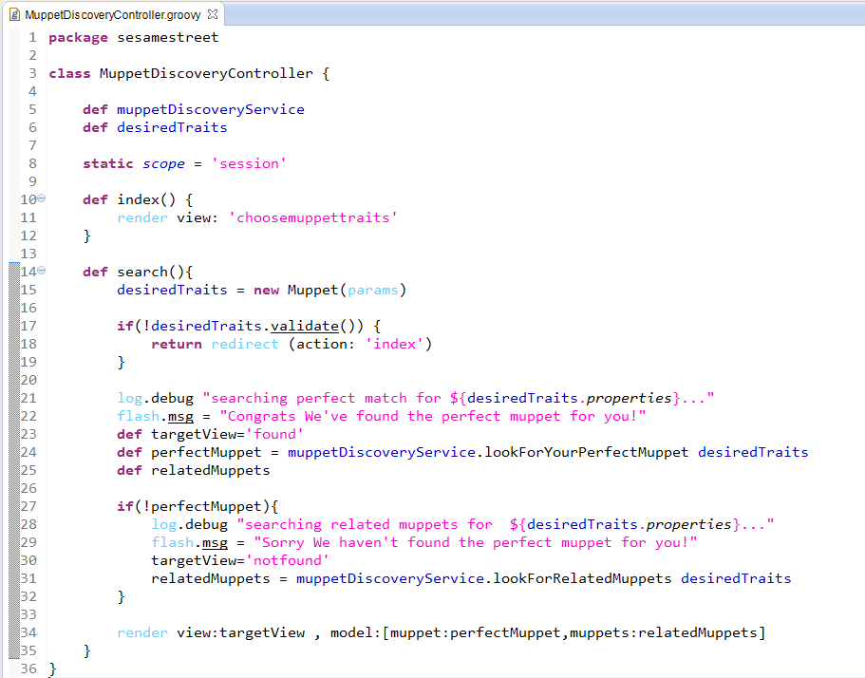

Stage IV: Create web layer
Create a controller (create-controller sesamestreet.MuppetDiscovery)

Slide 19
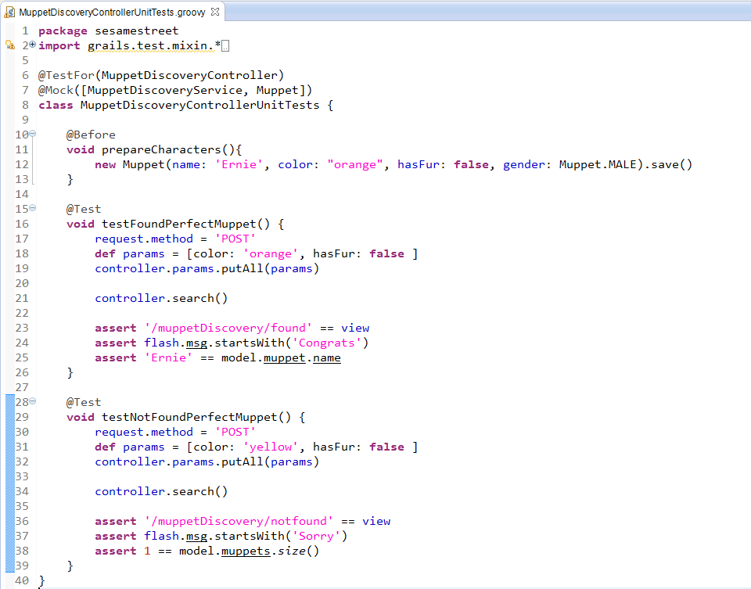

Stage IV: Create web layer
Refactor an write down test unit controller first of all

Slide 20
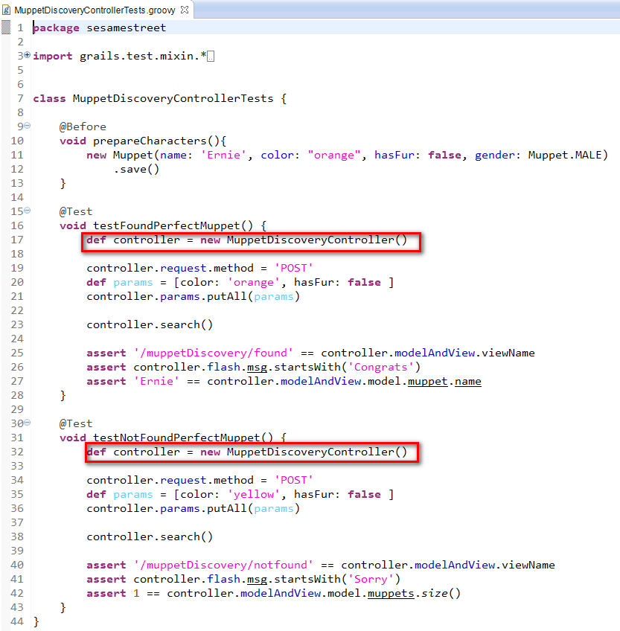
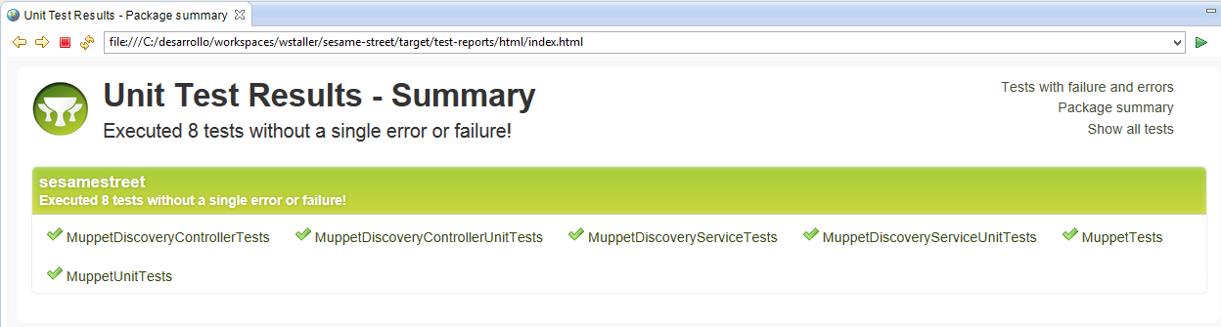

Stage IV: Create web layer
Create integration test for controller too!

Slide 21
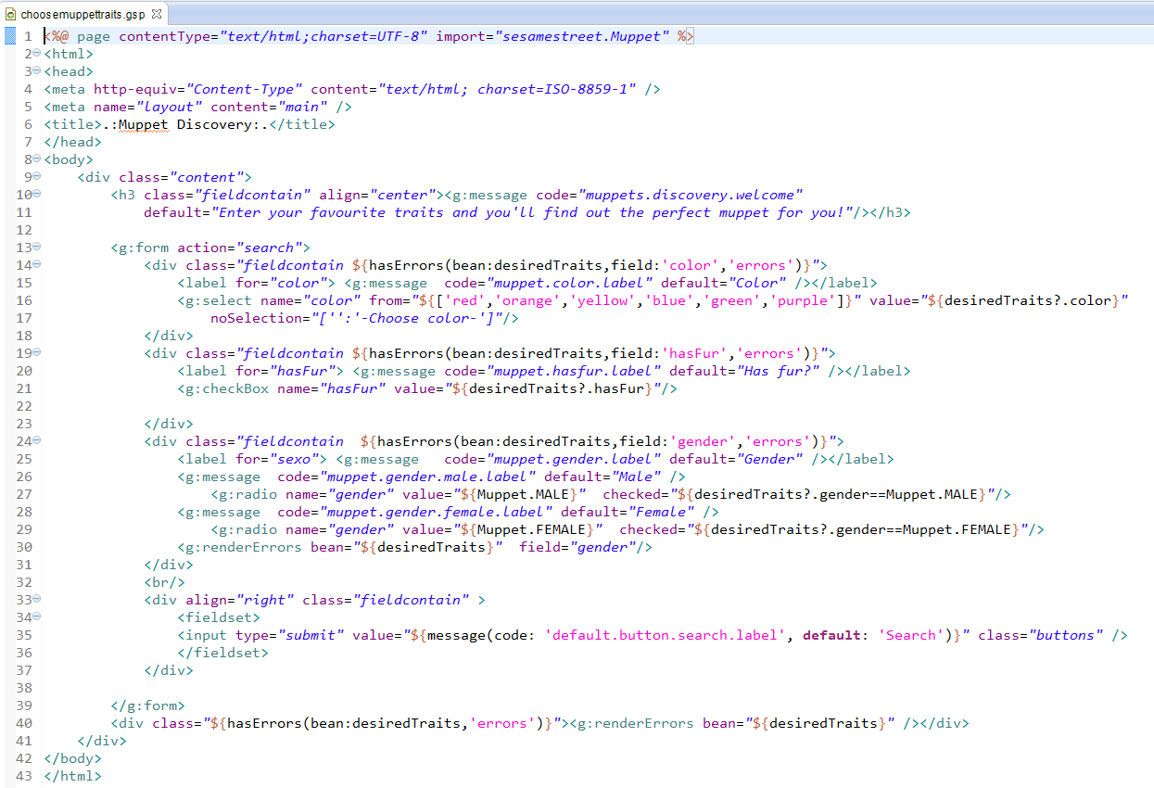

Stage IV: Create web layer
Let’s write down the initial GSP page of searches

Slide 22
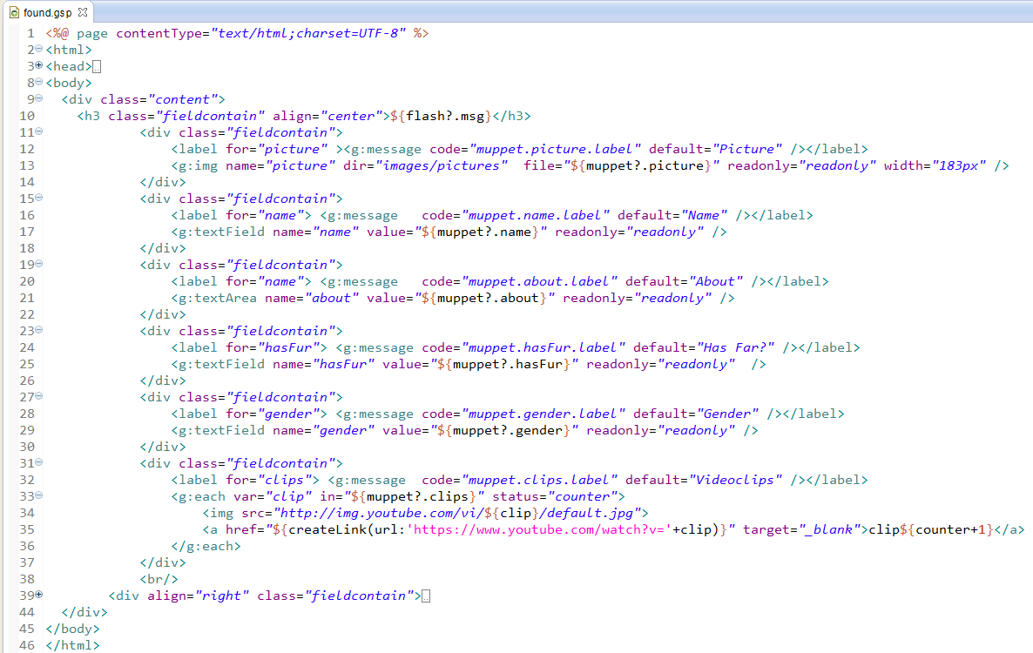
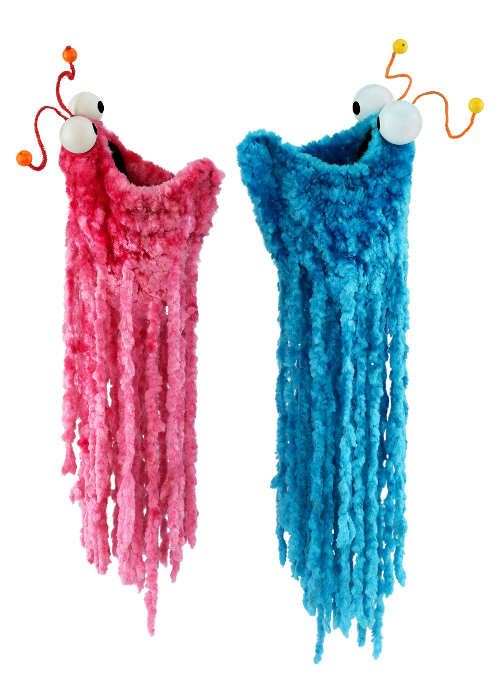
Stage IV: Create web layer
GSP page for the best matched muppet

Slide 23
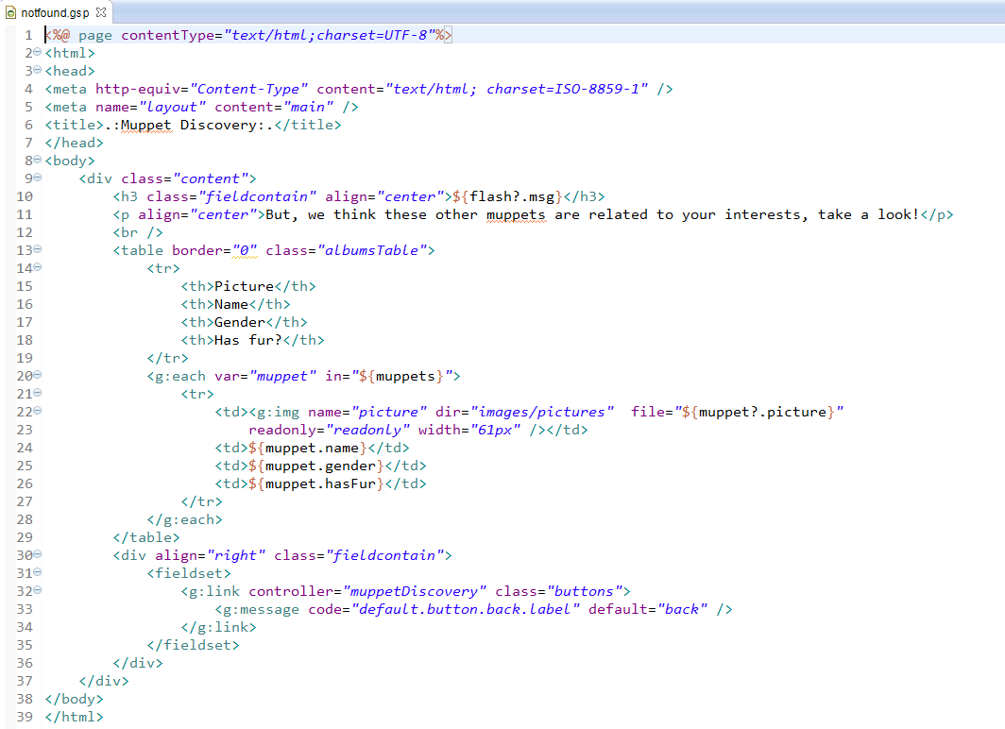
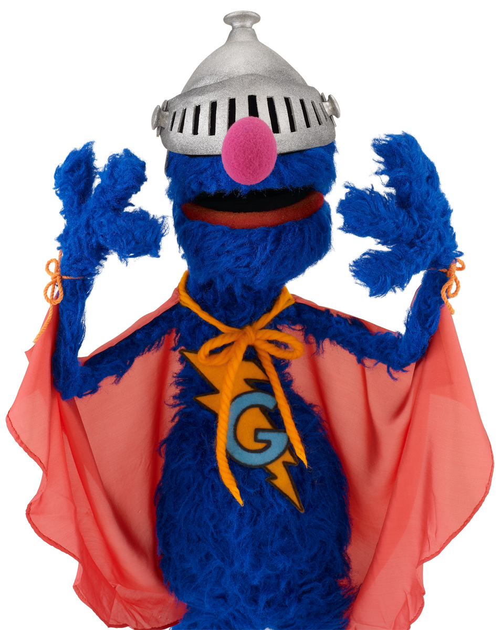
Stage IV: Create web layer
GSP page for no matched muppets

Slide 24
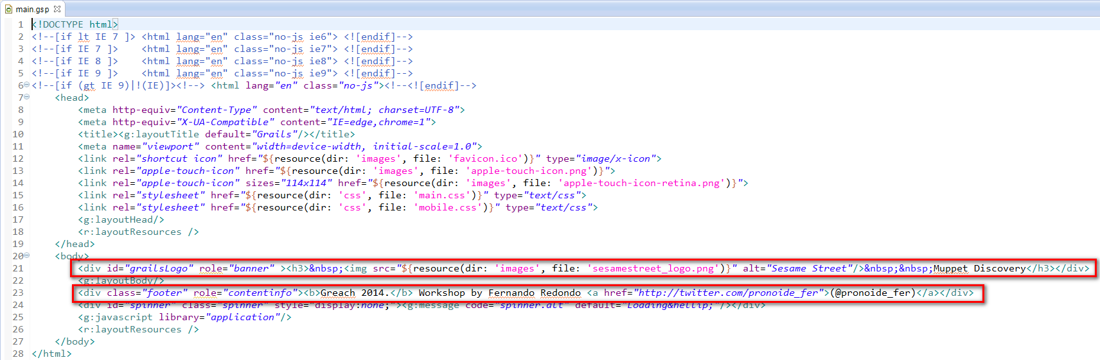
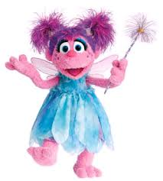
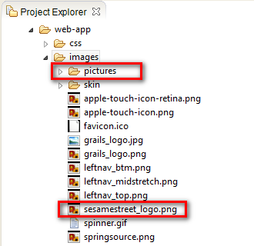
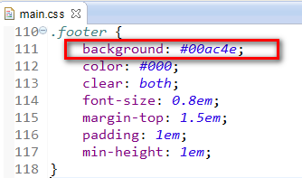
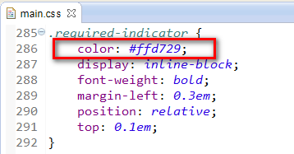
Stage IV: Create web layer
presentation fine tuning (main.gsp/main.css)

Slide 25
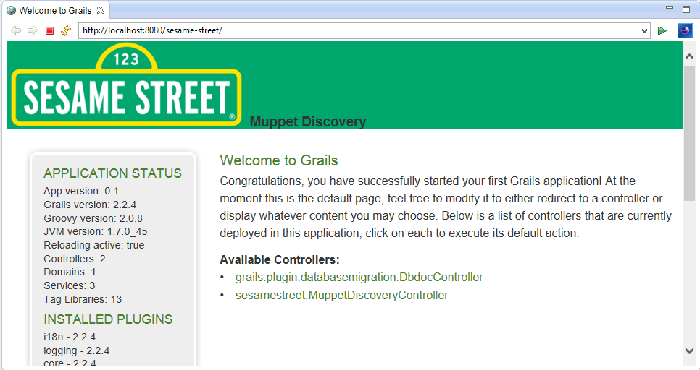
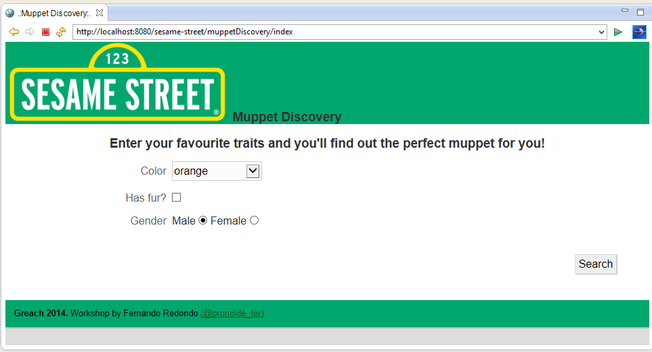

Stage V: Run Webapp
Start the web application (run-app)

Slide 26
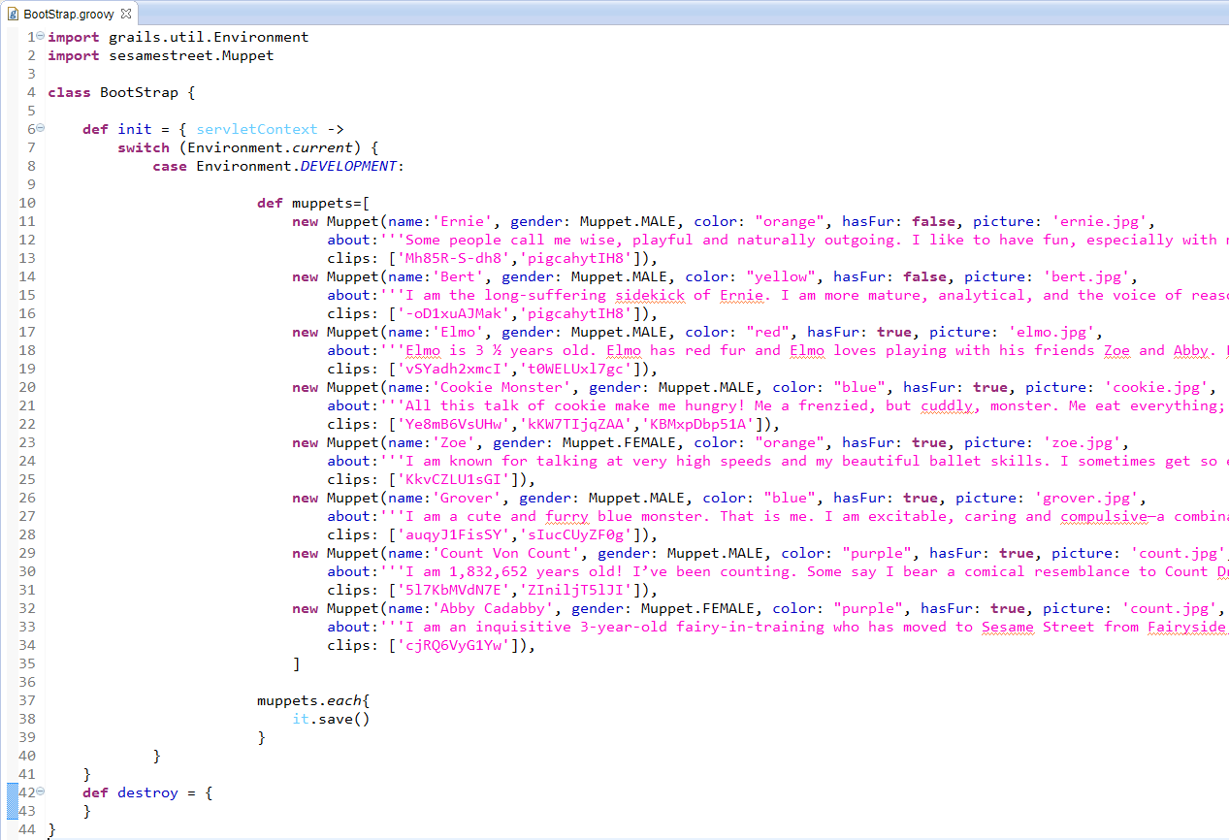
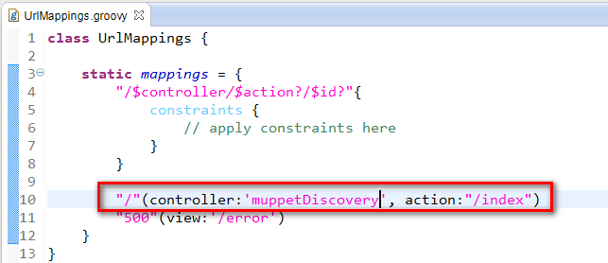

Stage V: Run Webapp
Load data and map default controller

Slide 27
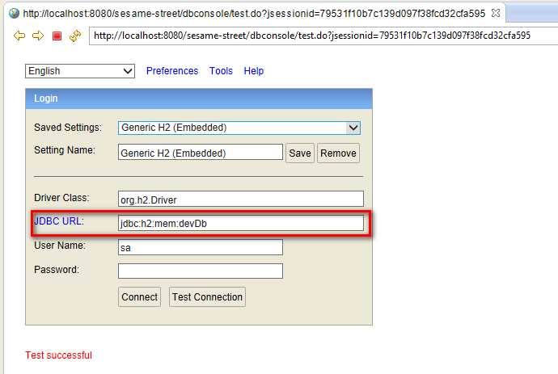

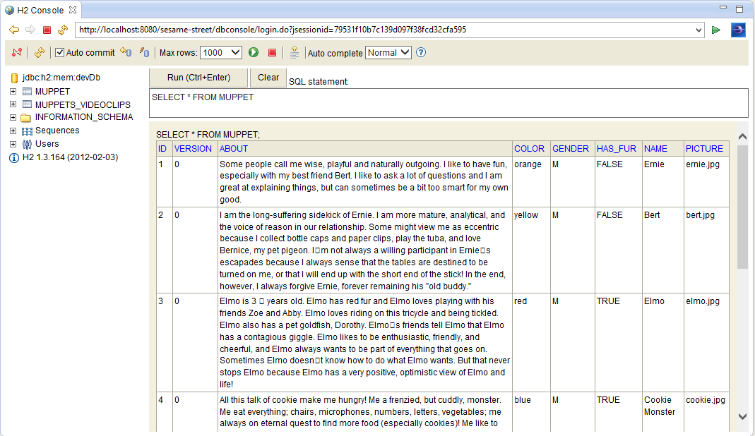
Stage V: Run Webapp
play with the database

Slide 28



Stage V: Run Webapp
play with the webapp

Slide 29



Extra ball: Spock test!
configure plugin and run (compile --refresh-depencies)

Slide 30


Extra ball: Spock test!
let’s write some specs samples for unit and integration

Slide 31



Extra ball: Spock test!
let’s write some specs samples for unit and integration and run them (test-app :spock)

Slide 32


We're done!
I wish i would have had this app 4 years ago… Meanwhile at the time being a new period begins: Superheroes and fairies, but that remains for the next year greach…

Slide 33

thanks!
@pronoide_fer
https://github.com/fredondo/
fredondo@pronoide.com
http://pronoide.com
http://blog.pronoide.es

